Slide 1



LIGHT
By Sanskriti
www.vaagaacademy.com

Slide 2
LEARNING OBJECTIVES
By the end of this presentation, you will master:
Nature and properties of light
Laws of reflection and refraction
Mirror and lens formulas with calculations
Advanced optical phenomena
Human eye and vision defects
Atmospheric optical effects

Slide 3
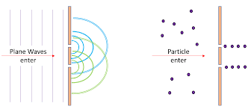
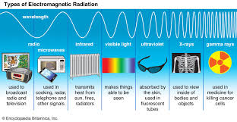
NATURE OF LIGHT
Dual Nature of Light
Light exhibits both:
Wave Nature - Interference, diffraction, polarization
Particle Nature - Photoelectric effect, emission/absorption
Key Properties:
Speed in vacuum: c = 3 × 10⁸ m/s
Electromagnetic radiation
Frequency range: 4.3 × 10¹⁴ Hz to 7.5 × 10¹⁴ Hz (visible light)
Wavelength range: 400 nm (violet) to 700 nm (red)

Slide 4
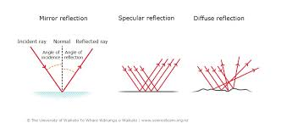
REFLECTION OF LIGHT
Laws of Reflection:
Incident ray, reflected ray, and normal lie in the same plane
Angle of incidence = Angle of reflection (∠i = ∠r)
Types of Reflection:
Regular Reflection: Smooth surfaces (mirrors)
Diffuse Reflection: Rough surfaces (paper, walls)
Important Terms:
Incident ray: Ray falling on surface
Reflected ray: Ray bouncing off surface
Normal: Perpendicular to surface at point of incidence
Point of incidence: Where light ray hits surface

Slide 5
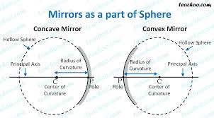
SPHERICAL MIRRORS
Types:
Concave Mirror (Converging)
Center of curvature (C) and focus (F) in front
Real focus
Convex Mirror (Diverging)
Center of curvature (C) and focus (F) behind
Virtual focus
Key Terms:
Pole (P): Center of mirror
Principal axis: Line joining pole and center of curvature
Radius of curvature (R): Distance from pole to center
Focal length (f): Distance from pole to focus
Relationship: f = R/2

Slide 6
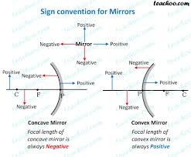
MIRROR FORMULA & CALCULATIONS
Mirror Formula:
1/f = 1/v + 1/u
Where:
f = focal length
v = image distance
u = object distance
Magnification Formula:
m = -v/u = h'/h
Sign Conventions:
Distances measured from pole
Towards mirror = negative
Away from mirror = positive
Above principal axis = positive
Below principal axis = negative

Slide 7
IMAGE FORMATION - CONCAVE MIRROR
Object Positions & Image Characteristics:
Beyond C: Real, inverted, diminished
At C: Real, inverted, same size
Between C and F: Real, inverted, magnified
At F: Image at infinity
Between F and P: Virtual, erect, magnified
Ray Diagrams Rules:
Ray parallel to axis → passes through focus after reflection
Ray through focus → becomes parallel after reflection
Ray through center → retraces its path

Slide 8
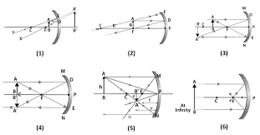

Slide 9
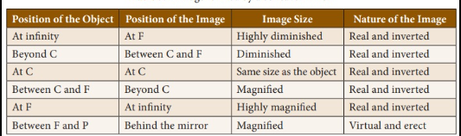

Slide 10
IMAGE FORMATION - CONVEX MIRROR
Characteristics:
Always forms virtual, erect, diminished images
Image always between pole and focus
Used as rear-view mirrors in vehicles
Applications:
Security mirrors in shops/hospitals
Street light reflectors
Vehicle headlights (diverging beam)

Slide 11
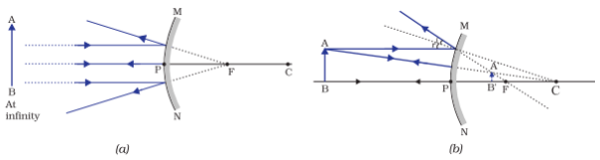

Slide 12
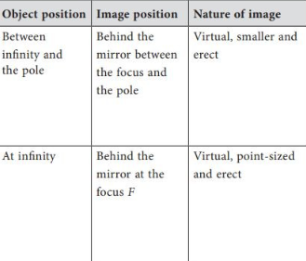

Slide 13
REFRACTION OF LIGHT
Definition:
Bending of light when it passes from one transparent medium to another
Laws of Refraction (Snell's Law):
Incident ray, refracted ray, and normal lie in same plane
n₁sin θ₁ = n₂sin θ₂
Refractive Index:
n = c/v = sin i/sin r
Where:
c = speed of light in vacuum
v = speed of light in medium
i = angle of incidence
r = angle of refraction

Slide 14
CRITICAL ANGLE & TOTAL INTERNAL REFLECTION
Critical Angle (θc):
Angle of incidence in denser medium for which angle of refraction = 90°
sin θc = 1/n (for air interface)
Total Internal Reflection:
When angle of incidence > critical angle
Complete reflection occurs
No refraction takes place
Applications:
Optical fibers
Prisms in periscopes
Diamond sparkle
Mirage formation

Slide 15
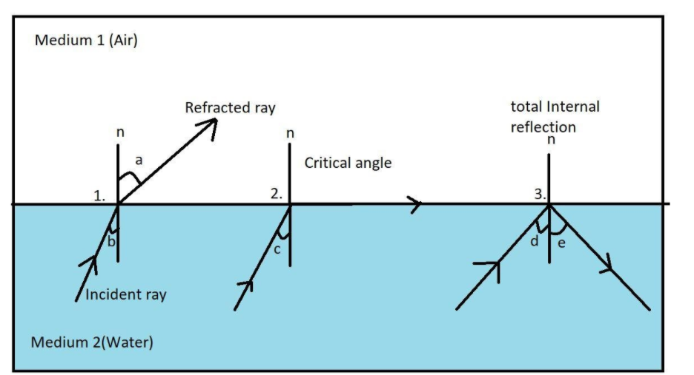

Slide 16
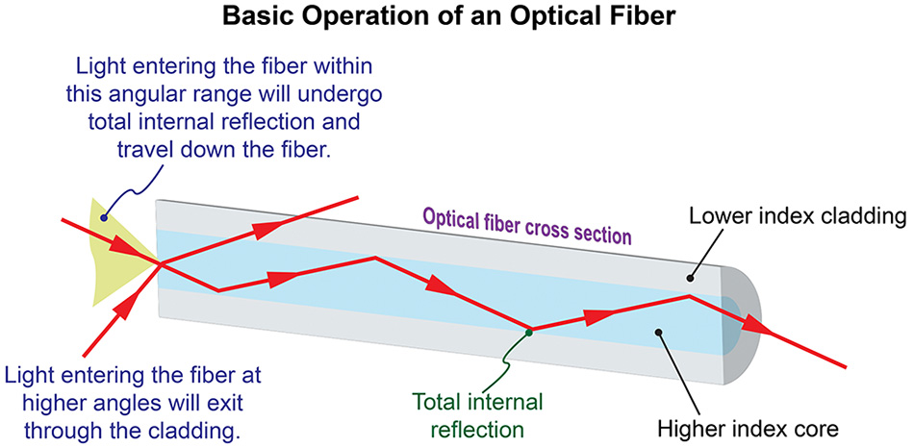

Slide 17
SPHERICAL LENSES
Types:
Convex Lens (Converging)
Thicker at center
Converges parallel rays
Concave Lens (Diverging)
Thinner at center
Diverges parallel rays
Key Terms:
Optical center (O): Center of lens
Principal focus (F): Point where parallel rays converge/appear to diverge
Focal length (f): Distance from optical center to focus
Principal axis: Line passing through centers of curvature

Slide 18
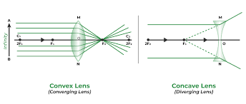

Slide 19
LENS FORMULA & CALCULATIONS
Lens Formula:
1/f = 1/v - 1/u
Power of Lens:
P = 1/f (in meters) Unit: Diopter (D)
Magnification:
m = v/u = h'/h
Sign Convention:
Object side: negative distances
Image side: positive distances
Above axis: positive heights
Below axis: negative heights

Slide 20
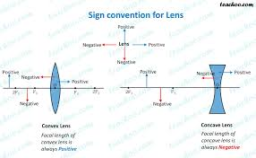

Slide 21
IMAGE FORMATION - CONVEX LENS
Object Positions & Images:
Beyond 2F: Real, inverted, diminished
At 2F: Real, inverted, same size
Between 2F and F: Real, inverted, magnified
At F: Image at infinity
Between F and O: Virtual, erect, magnified
Ray Diagram Rules:
Ray parallel to axis → passes through focus
Ray through optical center → goes straight
Ray through focus → becomes parallel

Slide 22
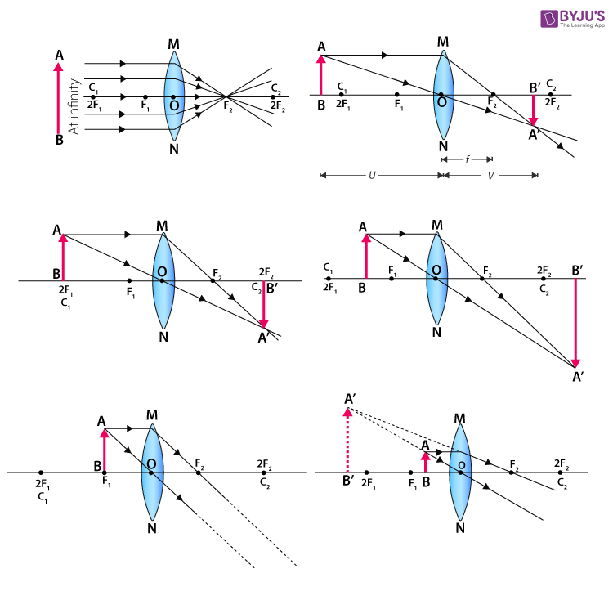

Slide 23
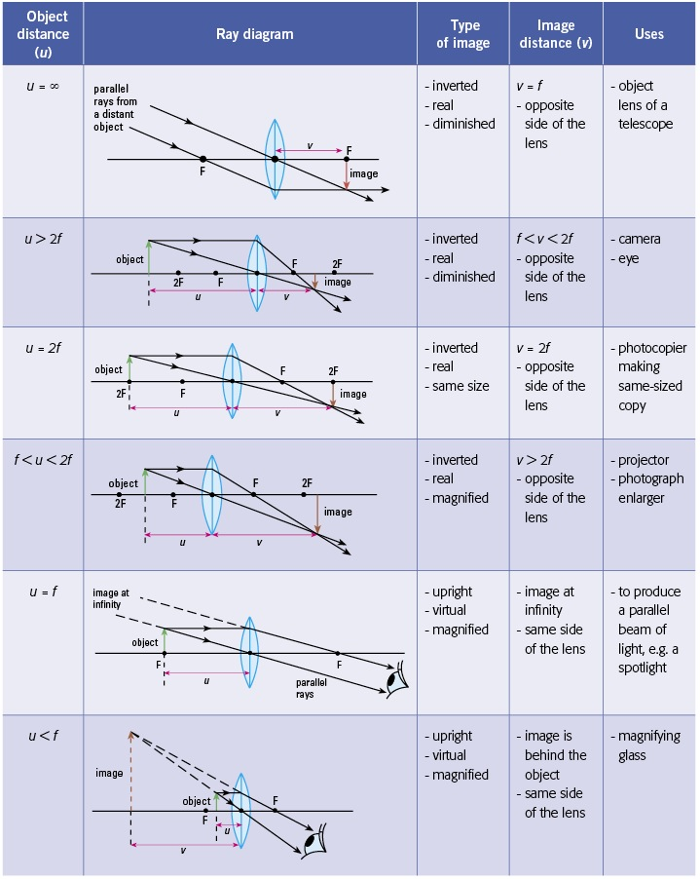

Slide 24
IMAGE FORMATION - CONCAVE LENS
Characteristics:
Always forms virtual, erect, diminished images
Image always on object side
Image always between optical center and focus
Applications:
Correcting myopia (short-sightedness)
Wide-angle lenses in cameras
Peepholes in doors

Slide 25
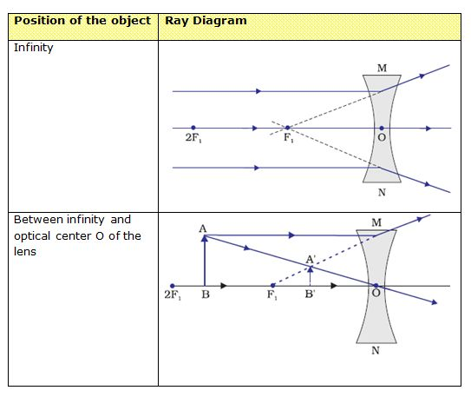

Slide 26
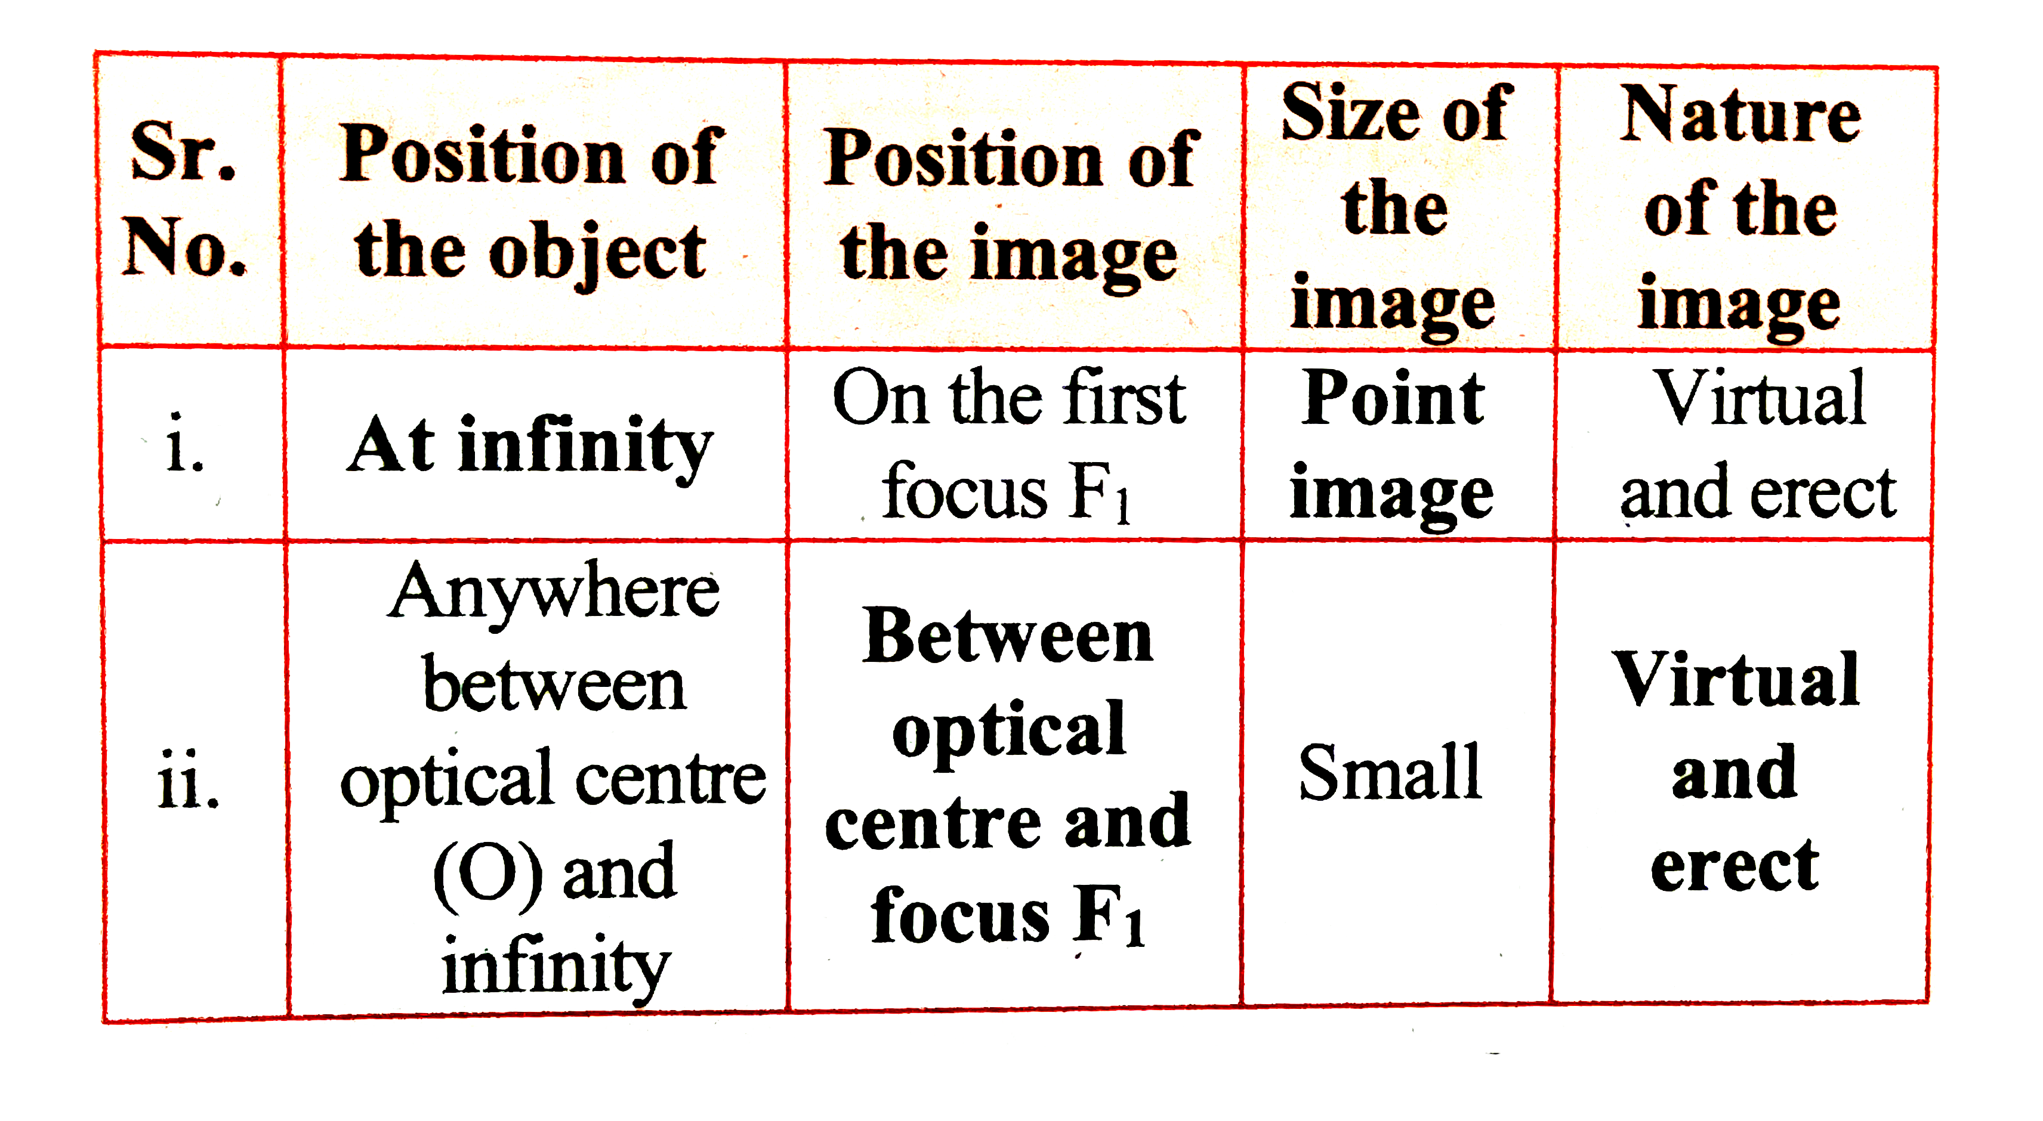

Slide 27
HUMAN EYE - STRUCTURE
Parts and Functions:
Cornea: Primary refraction (40D power)
Iris: Controls pupil size
Pupil: Aperture for light entry
Lens: Fine focusing (15-20D variable power)
Retina: Light-sensitive screen
Optic nerve: Carries signals to brain
Process of Vision:
Light enters through cornea
Iris adjusts pupil size
Lens adjusts for focusing
Image forms on retina
Brain interprets signals

Slide 28
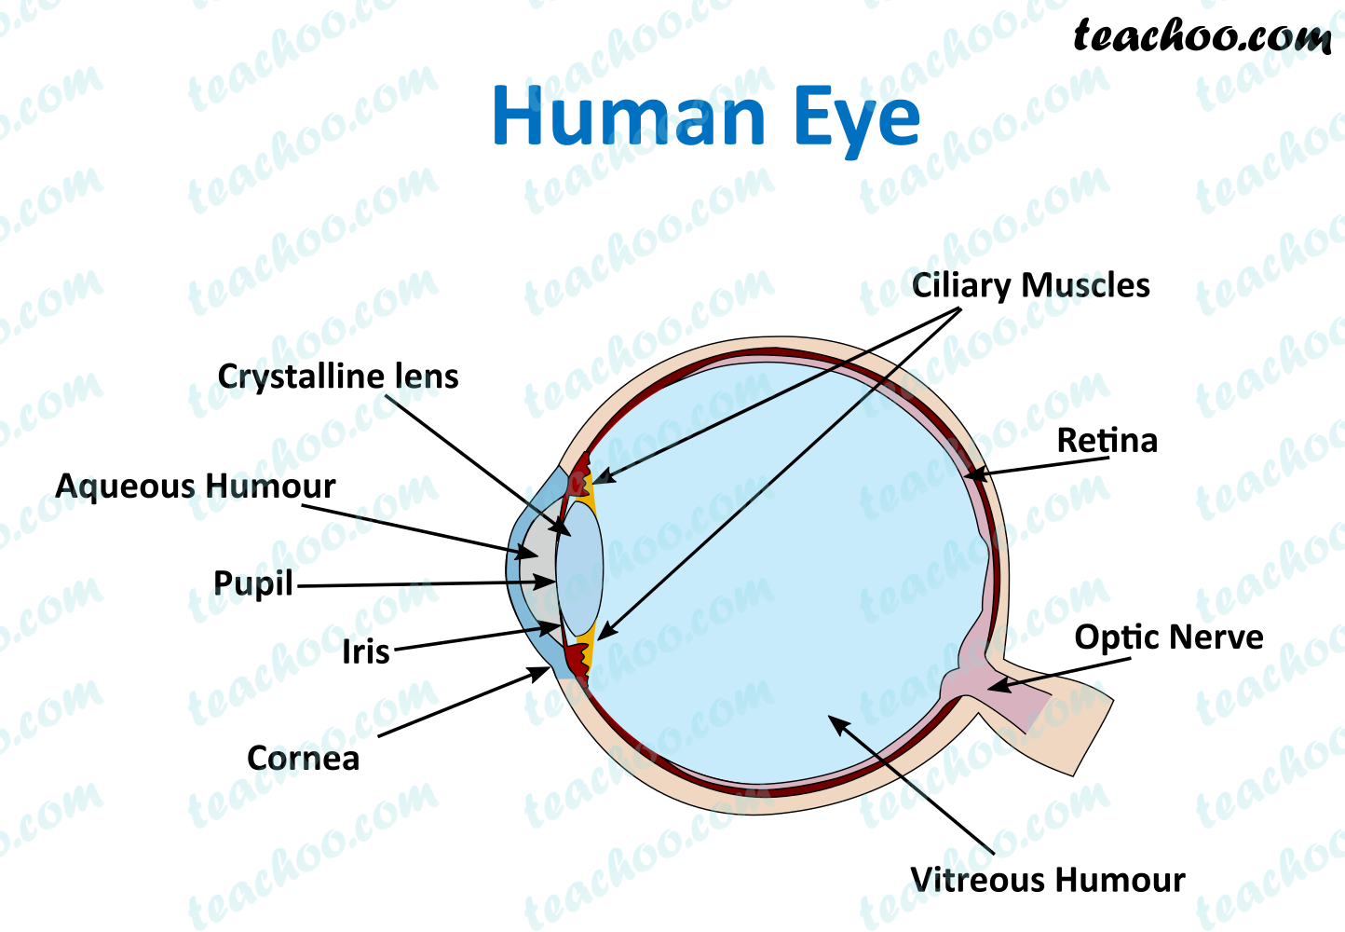

Slide 29
ACCOMMODATION & VISION DEFECTS
Accommodation:
Ability to change focal length of eye lens
Near point: 25 cm (normal eye)
Far point: Infinity (normal eye)
Vision Defects:
Myopia (Short-sightedness)
Can't see distant objects clearly
Correction: Concave lens
Hypermetropia (Long-sightedness)
Can't see near objects clearly
Correction: Convex lens
Astigmatism
Unequal curvature of cornea
Correction: Cylindrical lens

Slide 30
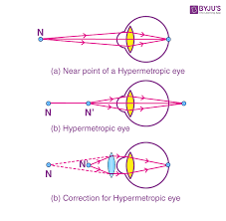
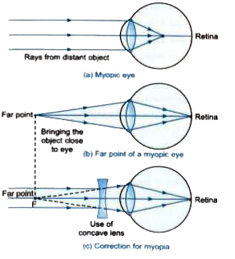
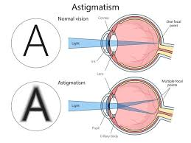

Slide 31
ATMOSPHERIC PHENOMENA
Scattering of Light:
Rayleigh Scattering: λ⁻⁴ dependence
Blue light scattered more than red
Why sky is blue: More blue light reaches our eyes
Why sunset is red: Blue light scattered away, red reaches us
Other Phenomena:
Rainbow: Dispersion + Total internal reflection in water droplets
Mirage: Total internal reflection due to temperature gradients
Twinkling of stars: Atmospheric refraction variations

Slide 32
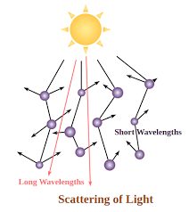
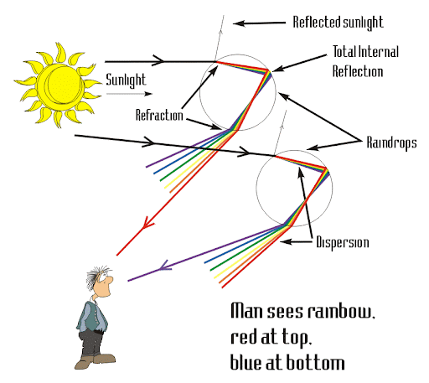
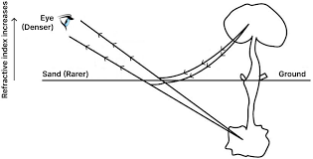

Slide 33
DISPERSION & PRISMS
Dispersion:
Splitting of white light into constituent colors
Different colors have different refractive indices
Red light deviates least, violet most
Prism Formula:
δ = A + i - r (for minimum deviation) n = sin[(A + δm)/2]/sin(A/2)
Where:
δ = angle of deviation
A = angle of prism
δm = minimum deviation
Applications:
Spectrometers
Optical instruments
Study of atomic spectra

Slide 34
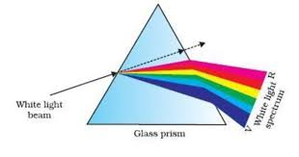

Slide 35
OPTICAL INSTRUMENTS - BASICS
Simple Microscope (Magnifying Glass):
Single convex lens
Object placed between F and optical center
Magnification: m = D/f (D = 25 cm)
Compound Microscope:
Two convex lenses (objective + eyepiece)
Total magnification: m = mo × me
Used for observing small objects
Telescope:
For observing distant objects
Magnifying power: fo/fe

Slide 36
Questions
MIRRORS - Basic Problems
Problem 1: A concave mirror has a focal length of 15 cm. An object is placed 30 cm in front of the mirror. Find: a) Image distance b) Magnification c) Nature of the image
Problem 2: A convex mirror has a radius of curvature of 40 cm. Where should an object be placed to get an image that is 1/3 the size of the object?
Problem 3: An object 5 cm tall is placed 20 cm from a concave mirror of focal length 12 cm. Find the height and nature of the image formed.
Problem 4: A dentist uses a concave mirror with focal length 2 cm. If the tooth is 1.5 cm from the mirror, find the magnification and image distance.
LENSES - Basic Problems
Problem 5: A convex lens has focal length 20 cm. An object is placed 30 cm from the lens. Calculate: a) Image distance b) Magnification c) Nature of image
Problem 6: A concave lens of focal length -15 cm forms an image 10 cm from the lens. Find the object distance and magnification.
Problem 7: An object 4 cm high is placed 25 cm from a convex lens of focal length 15 cm. Determine the size and position of the image.
Problem 8: Calculate the power of a lens that can produce a virtual image at 25 cm when the object is placed at 50 cm from the lens.

Slide 37
MIRRORS - Intermediate Problems
Problem 9: A concave mirror produces a real image 3 times larger than the object. If the object is 16 cm from the mirror, find: a) Focal length of mirror b) Image distance c) Radius of curvature
Problem 10: An object is placed between the pole and focus of a concave mirror of focal length 10 cm. If the virtual image formed is twice the height of the object, find the object distance.
Problem 11: A spherical mirror forms an erect image twice the size of the object. If the object is 20 cm from the mirror, find: a) Type of mirror b) Focal length c) Image distance
Problem 12: Two plane mirrors are inclined at 60° to each other. A point object is placed between them. Find the number of images formed and draw the ray diagram.
LENSES - Intermediate Problems
Problem 13: A convex lens forms a real image 4 times larger than the object when the object is 15 cm from the lens. Find: a) Focal length of lens b) Image distance c) Power of lens
Problem 14: An object placed 40 cm from a lens forms a virtual image at 120 cm from the lens on the same side. Determine: a) Type of lens b) Focal length c) Magnification
Problem 15: A lens of power +2.5 D forms a virtual image at 30 cm from the lens. Calculate: a) Focal length b) Object distance c) Magnification
Problem 16: A concave lens of focal length 20 cm is placed 10 cm behind a convex lens of focal length 15 cm. An object is placed 30 cm in front of the convex lens. Find the final image position and magnification.

Slide 38
COMPLEX MIRROR PROBLEMS
Problem 17: A concave mirror and a convex lens are placed 50 cm apart. The mirror has focal length 15 cm and lens has focal length 10 cm. An object is placed 20 cm in front of the lens (away from mirror). Find the position and nature of the final image.
Problem 18: A ray of light incident on a concave mirror at an angle of 30° with the principal axis passes through the focus after reflection. If the distance between the pole and point of incidence is 15 cm, find the focal length of the mirror.
Problem 19: A concave mirror of radius 30 cm has an object placed at distance x from the pole. The image formed is real and 4 times smaller than the object. Find x and the image distance.
Problem 20: A person standing 1.5 m in front of a plane mirror walks 0.5 m toward the mirror. How far is the person from his image after walking?
COMPLEX LENS PROBLEMS
Problem 21: Two thin lenses of focal lengths +10 cm and -5 cm are placed in contact. An object is placed 15 cm from this combination. Find: a) Equivalent focal length b) Image distance c) Overall magnification
Problem 22: A convex lens of focal length 20 cm is cut into two equal halves along its principal axis. The two halves are separated by 2 cm. An object is placed 30 cm from the first half. Find where the final image is formed.
Problem 23: A glass lens (n = 1.5) has focal length 20 cm in air. What will be its focal length when immersed in water (n = 1.33)?
Problem 24: A double convex lens has radii of curvature 15 cm and 25 cm. If made of glass with refractive index 1.6, find its focal length and power.

Slide 39
CHALLENGING PROBLEMS
Problem 25: A luminous object is placed 20 cm from a converging lens of focal length 15 cm. A plane mirror is placed 25 cm behind the lens. Find all image positions and their magnifications.
Problem 26: An equiconvex lens of focal length f is cut along a plane perpendicular to the principal axis into two identical parts. What is the focal length of each part?
Problem 27: A concave mirror of focal length 10 cm is placed horizontally at the bottom of a beaker. Water is poured into the beaker to a height of 5 cm above the mirror. If refractive index of water is 4/3, find the equivalent focal length of the system.
Problem 28: A ray of light passes through a glass prism (A = 60°, n = 1.5) and then reflects from a concave mirror of focal length 30 cm placed 40 cm away. If the ray retraces its path, find the angle of incidence on the prism.
Problem 29: A person with normal near point (25 cm) uses a magnifying glass of power 10 D. Calculate: a) Maximum magnification b) Distance of object for maximum magnification c) Magnification when image is formed at infinity
Problem 30: Two identical convex lenses each of focal length 10 cm are placed 30 cm apart. An object is placed 15 cm in front of the first lens. Find: a) Position of image formed by first lens b) Position of final image c) Overall magnification d) Nature of final image

